Slide 1
Hormonal Regulation of Plant Cold Stress Tolerance

Slide 2
Cold Stress in Plants
Stress – an external factor, exerting disadvantegous effects
Stress types
  biotic – pathogenes (fungi, viruses, viroides), herbivores, parasite plants
  abiotic – high, low temperatures, dehydration, high concentration of salts, hypoxy (hyperhydration of roots and oxygen insufficiency)
Two types of cold stress by temperature
  Chilling stress (low temperatures above zero – about (+) 5°С)
  Freezing stress (low temperatures below zero – about (–) 7-8°С)
Plant types by ways of dealing with cold stress
  Plants resistant to cold stress
  Postponers of stress (can tolerate only short term stress effects)
  Plants escaping stress effects (for examples annual plants, which go through the coldest periods of the year in the form of seeds)
Complexity of stress effects (for example cold stress combines the effects of dehydration)

Slide 3

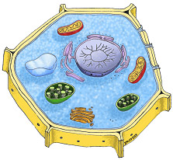
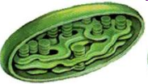
Effect of cold stress on the plant cell
V. Chlorophyll
transforms
into Pheophytin
Organic acids
IV. Damage
in the photosynthetic
and respiratory chains
Extracellular ice
II. Leakage of
H₂O and water-soluble
compounds from the cell
and dehydration
photodamage
III. Protein denaturation and accumulation of toxic compounds
I. Disruption
in the membrane
functions

Slide 4
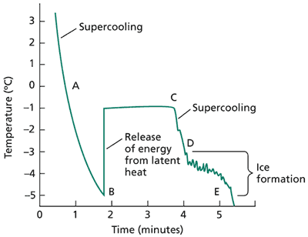
Fluctuations of Temperature
In the Formation of Ice in the Plant Cells
B – C
D – E
Notes:
Temperature of parenchyma cells in cucumber (Cucumis sativus) fruit during freezing. The temperature was recorded with an electronic device, a thermistor, inserted into a 5 × 20 mm cylinder of tissue and immersed in a coolant at –5.8°C. (A–B) Supercooling. (B–C) Release of heat during freezing in cell walls and intercellular spaces. (C–D) Supercooling. (D–E) Small heat spikes released during intracellular freezing of individual protoplasts. (After Brown et al. 1974.)
Свръхохлаждане – преохлаждане, при което температурата пада, без да се образува лед

Slide 5
Molecular Bases of Cold Stress Tolerance
Low temperatures
Ice formation in the apoplast
Cold Stress
Osmotic stress
ABA
Sensor
Ca2+
Phosphprotein cascades
IP pathway
DREB2
CBF4
Ca²⁺
GA2ox
CBF1-3
ABA
MYBR
Transcription
factors
GA
DELLA
MYCR
Growth
CRT/DRE
ABRE
RAB/LEA/DHN

Slide 6
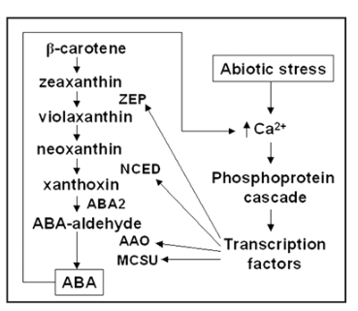
ABA as a Stress Hormone

Slide 7
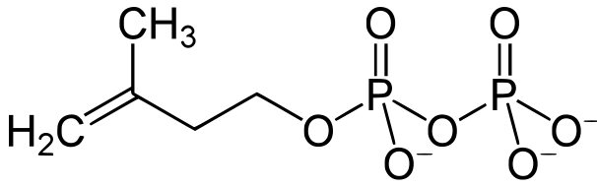
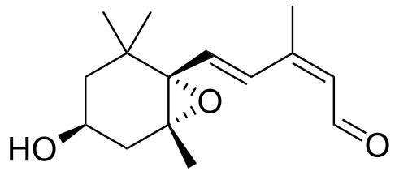
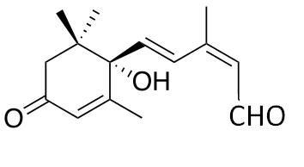
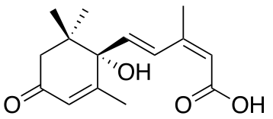
ABA Biosynthetic Pathway
IPP
Chloroplast
zeaxanthin
ABA1/ZEP
All-trans-violaxanthin
ABA4
9-cis neoxanthin 9-cis violaxanthin
NCED
xanthoxin
ABA2
Abscisic aldehyde
AAO3
ABA

Slide 8
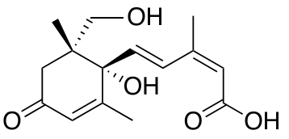
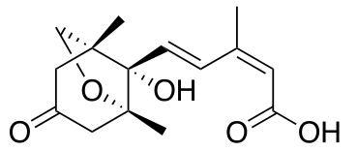
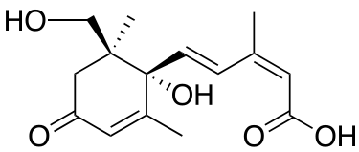
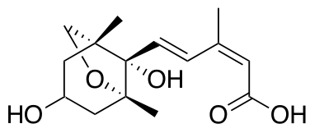
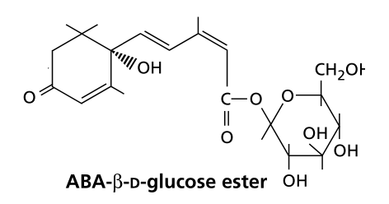
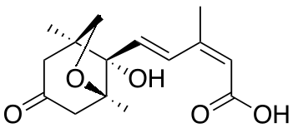
ABA degradation/inactivation pathways
Inactivation by oxydation
CYP707A
ABA
8´ hydroxy ABA
Phaseic acid
glucosidase
glucosil-transferase
9´ hydroxy ABA
Dihydrophaseic acid
Hydroxy ABAs maintain substantial biological activities
ABA-glucose ester
Neophaseic acid
Inactivation by conjugation with monosaccharides

Slide 9
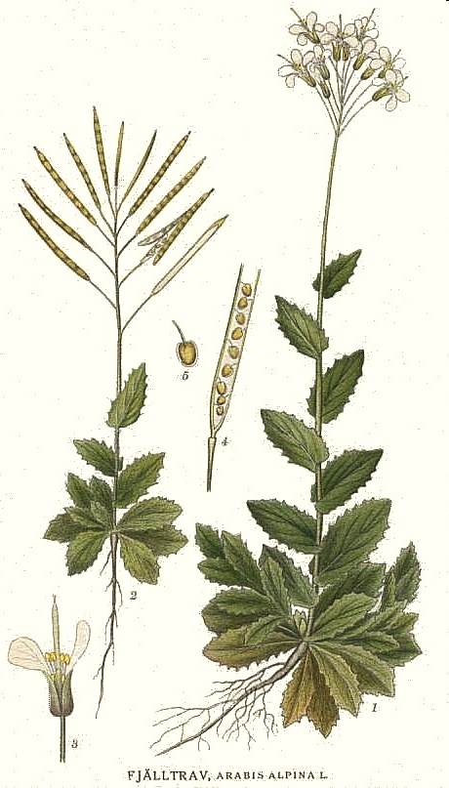
Object of Research
Arabis alpina L. – A Model Plant Used in the Cold Stress Adaptation Research
A perrenial mountain plant from Brassicaceae family
Grows at altitude from 500 m to 3200 m (deppending on lattitude)
It grows in the most European countries, in Canaria islands, North and East Africa, Ethiopia, Arabian Peninsula and Central Asia
Its genomic size is about 375 Mb (n = 8 chromosomes)
Self-fertile diploid
Its freezing tolerance is determined by the presence of genes, proteins and metabolites in tolerant (T) as opposed to non tolerant (NT) genotypes from A. alpina.

Slide 10
Experimental Scheme
Cultivation of T (tolerant) and NT (non tolerant) plants at 20°C
Acclimatisation at 4°C for 4 days (16/8 photoperiod)
Freezing stress at -6°C (12h, dark).
Adaptation to frost
(involves the evolutionary selection
of specific gene alleles)
20°С 4°С, 4 d –6°С, 12h
Tolerant
Т20
T4
T4S
Non Tolerant
NT20
NT4
NT4S
20°С
control
-6°С
freezing
4°С
chilling
аклиматизация толеранс/
устойчивост
The different temperatures correspond
to different ecological niches,
where plants with different adaptation grow

Slide 11
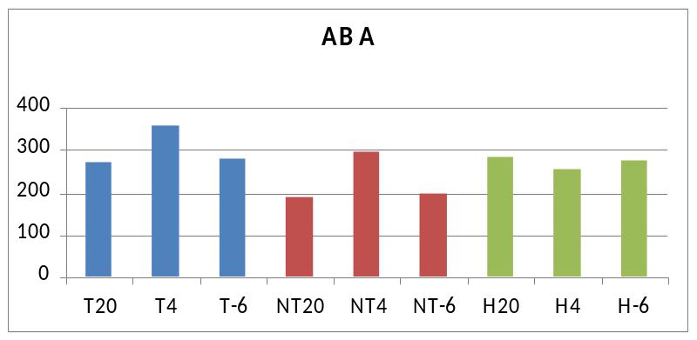
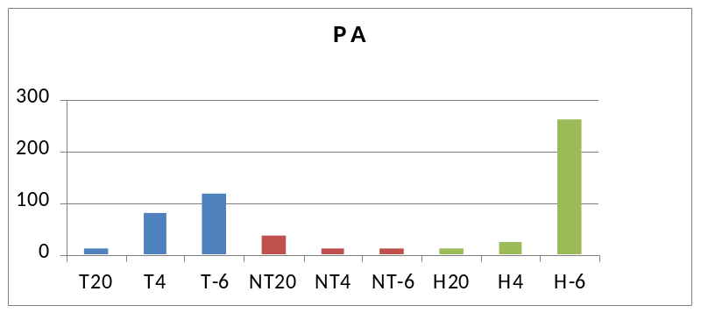
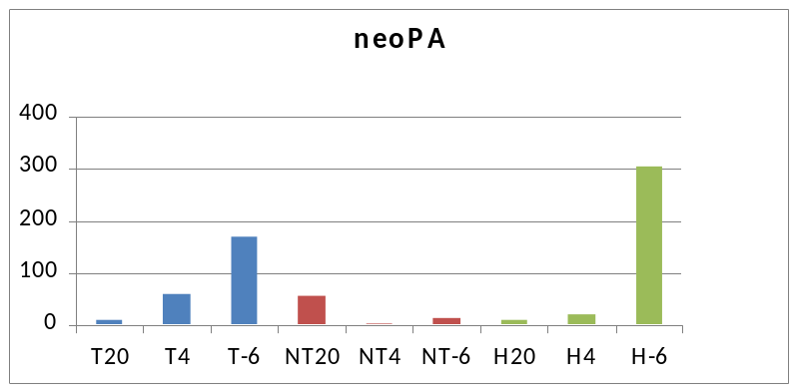
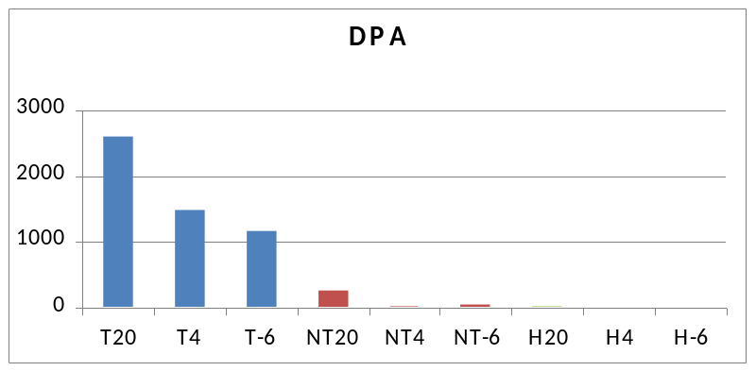
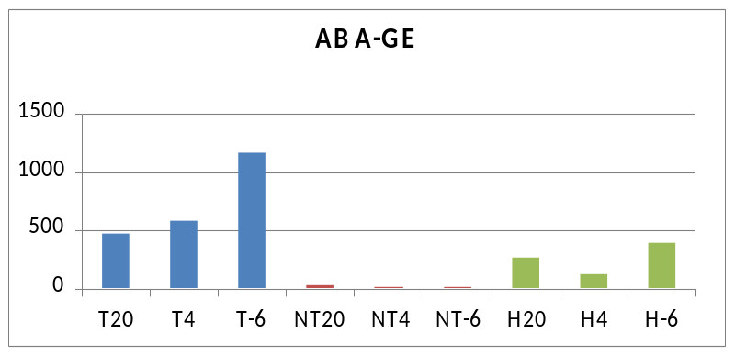
Content of ABA and the products of its inactivation

Slide 12
Transcriptional response of abscisic acid (ABA) metabolism and transport to cold and heat stress applied at the reproductive stage of development in Arabidopsis thaliana
K. N. Baron et al. (2012) Plant Science

Slide 13
Experimental setup
Arabidopsis thaliana at 22°С, 70% relative humidity and a photoperiod of 16h day/8h night
Exposure to stress (37°С и 0°С) was applied for 24h. Before that the transition between temperatures was performed by changing the temperature at a rate of 2°С/h.
ABA content was measured by competitive ELISA
Total RNA was isolated and assessed using RT-qPCR analysis

Slide 14
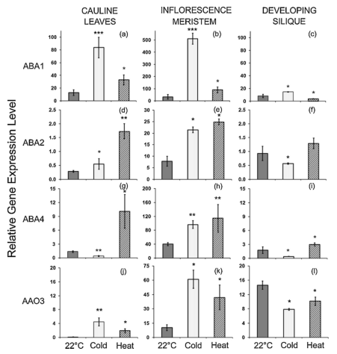
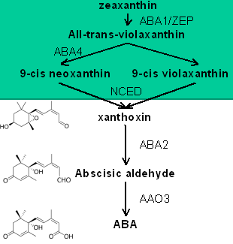
Expression of genes from the ABA biosynthetic pathway
K. N. Baron et al. (2012) Plant Science

Slide 15
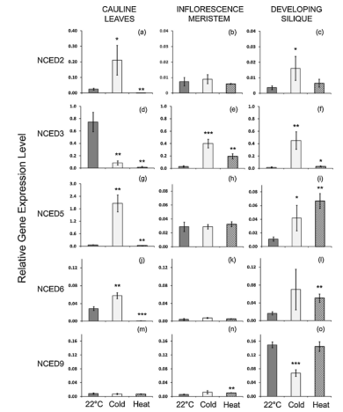
Expression of NCED genes at cold and heat stress
K. N. Baron et al. (2012) Plant Science

Slide 16
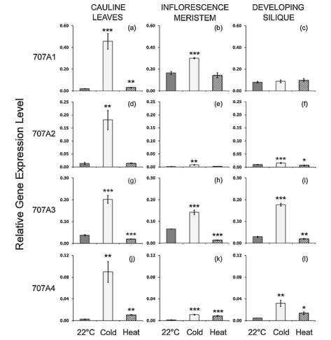
Expression of CYP707A genes
K. N. Baron et al. (2012) Plant Science

Slide 17
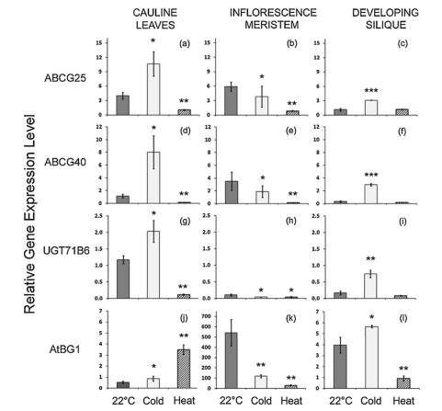
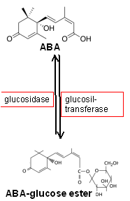
Expression of genes responsible for the transport and inactivation of ABA
K. N. Baron et al. (2012) Plant Science

Slide 18
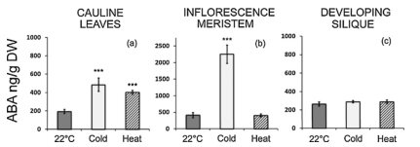
ABA content
K. N. Baron et al. (2012) Plant Science

Slide 19
Forthcoming Work
Analysis of gene transcription of biosynthetic and signal pathway of:
  ABA (ABA – aldehyde oxygenase, NCED, ZEP);
  Jasmonates (lipoxygenase - LOX, allene-oxide synthase – AOS);
  Gibberellins (GA3ox, GA20ox) by the means of qRT-PCR analisys

Slide 20
Thank you for your attention!

